Slide 1





Pembroke Primary School
Happy and secure, learning together.
Hapus, diogel gweithio efo'n gilydd.
Croeso
Notes:
Welcome to Pembroke Primary.
A bit about myself.
Introduction to the FP staff.
Any questions at the end.

Slide 2
The Daily Routine
Children are to be in school by 9a.m. Doors open at 8.50 a.m.
Break time is at 10.45 a.m.
Lunchtime is from 11.55 a.m. - 12.55 p.m.
The school day will finish at 3.15 p.m.
Children need to dropped off and collected by an adult from the class door.
Notes:
Children will be met at the gate by a member of staff, any late pupils will need to go to the office to sign in – they must be accompanied by an adult. If there is someone different collecting them from school, please let a member of staff know when you drop them off. We will provide a snack for the children at a cost of £1 a week.
Safety of the children is of utmost importance to us and you will be required to bring the children to the gate in the morning and be outside the classroom in order for us to release them. Whilst mentioning safety, I would like to inform you that Monmouthshire’s has a very strict policy regarding people who work within school, I can assure you that everyone who your child will be working with will have a Criminal Record Check, which is updated on a three yearly basis. Back gates will be locked throughout the school day and as from September, all staff will have an identity badge and visitors are always required to sign in and out and given a visitor badge.

Slide 3
Please let us know if:
Your child has any allergies or other specific medical requirements
Your child is absent from school
If you have an questions or concerns
A pack of consent forms will be issued in September regarding local trips, photographs etc.
Notes:
We have an open door policy and urge you to let us know any issues you may have. For children to succeed it is paramount that we work together.
Our current attendance target this year is 95%, and we ask that you support us in achieving this. We fully understand that at times, your child will be ill and unable to attend, however if this is the case please let us know as soon as possible – contact details will follow. If we do not hear from you this will not be authorised.

Slide 4
Home School Links
We need to work together to ensure your child achieves the best they can.
We would like you to read to and listen to your child read regularly
Learn nursery rhymes
Permissions slips/ money need to be returned as soon as possible
Snack money to be paid in advance, weekly or termly
Encouraging children to be independent with their dressing, toileting and eating
Notes:
We will teach your children the basic skills of reading, we ask that you provide the opportunities for the children to practice these skills.
In order for your child to participate in any local trips which are all planned to support their learning, we need permission! There is nothing worse that chasing permission on the day that our trip is taking place.

Slide 5
In September the children will have a staggered start.
This allows the staff and children to get to know each other in small groups and for the baseline to be started.

Slide 6
Help make your child’s entry as smooth as possible by ensuring:
All uniform is clearly labelled as well as other personal belongings
Children are able to dress themselves
P.E. Kits are in school all the time in a labelled bag
Children know if they are having sandwiches or school dinners
Children have a drinks bottle filled with water which they can re-fill in school
Notes:
Anything that moves needs to be labelled – many of the clothes, especially the jumpers will be the same size and the children don’t notice whose is whose.
Children need to be able to dress themselves, therefore we ask that if the children cannot tie their own laces, please do not buy them shoes with laces. Jewelery needs to be limited to a set of studs. – Please see prospectus for more information.
If children are having school dinners, dinner money needs to be in school.
In order to support us in making sure that registration and dinner times run as smoothly as possible, children need to know what they are having for dinner. And know that they cannot change their minds.

Slide 7
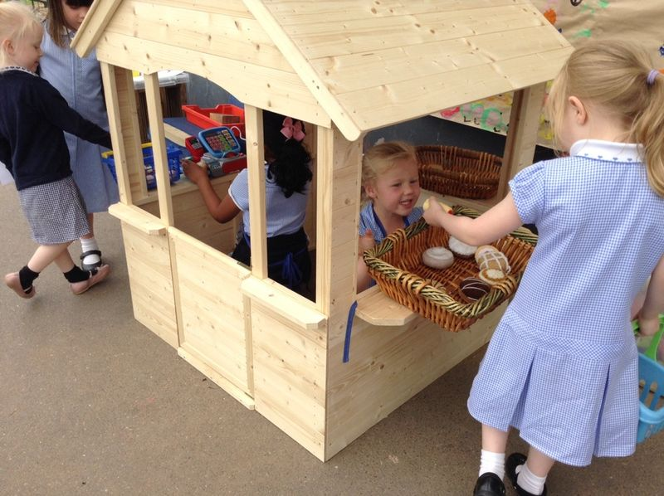
Learning through play in the Foundation Phase
at Pembroke Primary School

Slide 8
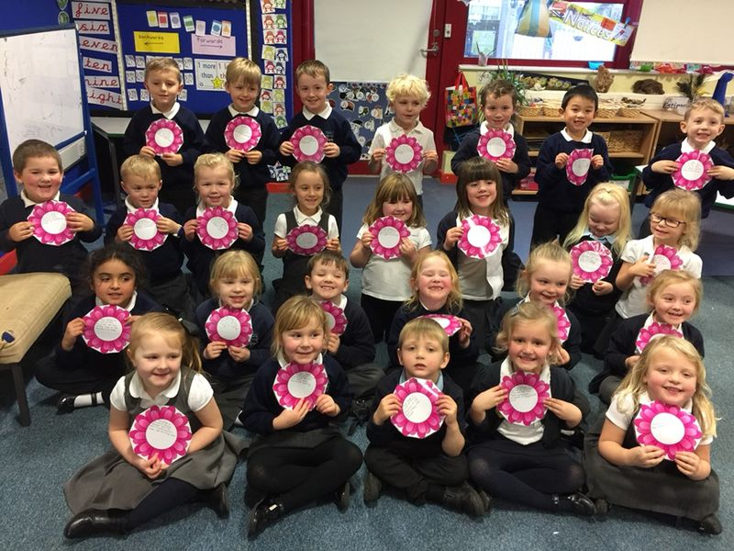
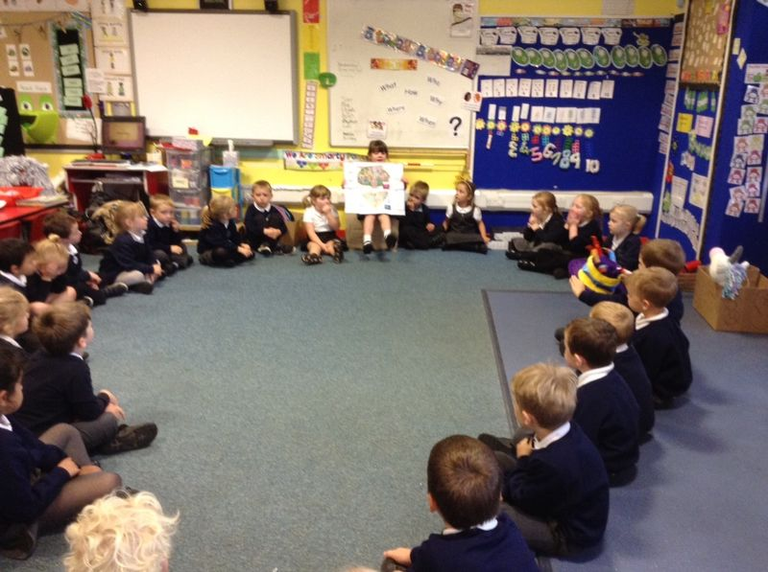
Personal and Social Development, Well-being and Cultural Diversity is at the heart of the Foundation Phase.
Children benefit from opportunities to develop their understanding of different members of the community.
Learn to interact with others who are similar and different from themselves.

Slide 9
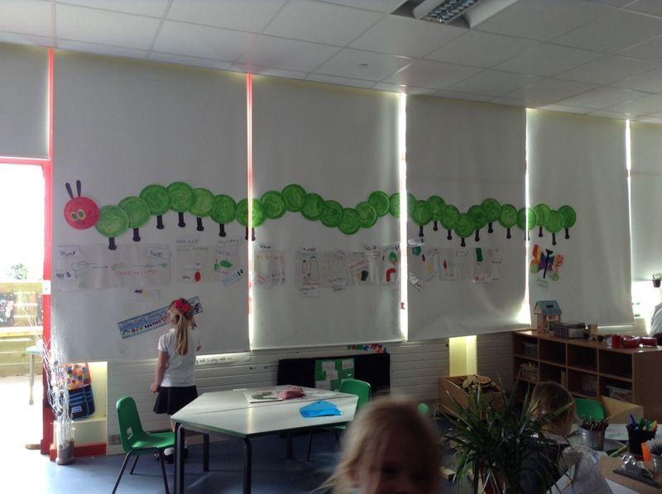
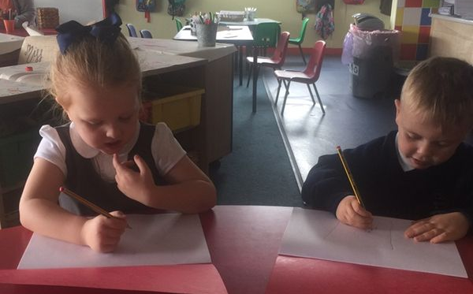
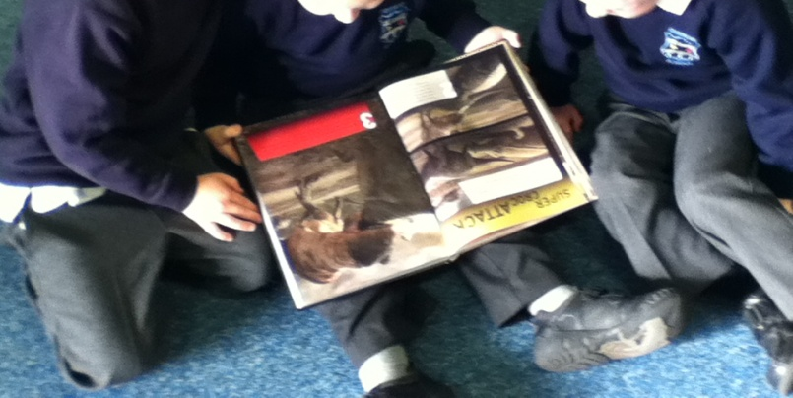
LANGUAGE, LITERACY AND COMMUNICATION SKILLS
Children are given plenty of opportunities to make marks and write in meaningful activities. Learning to read is fun and the children use role play and drama activities to ‘act out’ roles and characters from stories.
We use a scheme called ‘Read, Write, Inc.’ to teach phonics.
Literacy skills are taught discretely and across the curriculum.

Slide 10
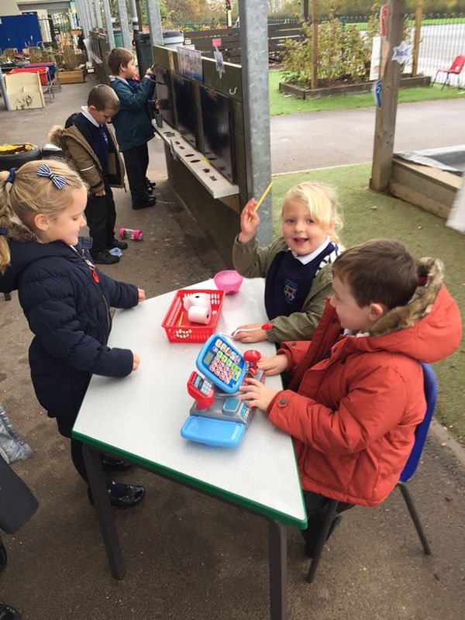
MATHEMATICAL DEVELOPMENT
Children are given opportunities to develop awareness of the use and value of money. Before undertaking measuring activities they are encouraged to predict and estimate. They collect and organise information in simple ways.
Numeracy skills are taught discretely and across the curriculum.

Slide 11
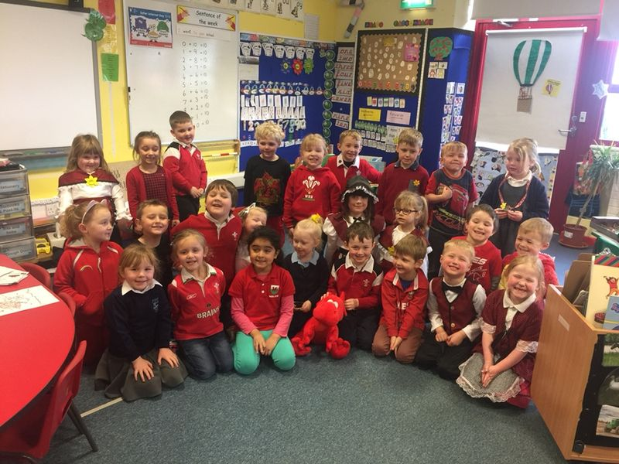
WELSH LANGUAGE DEVELOPMENT
We integrate the Welsh language naturally into activities that children experience from day to day. The children also experience short structured sessions.

Slide 12
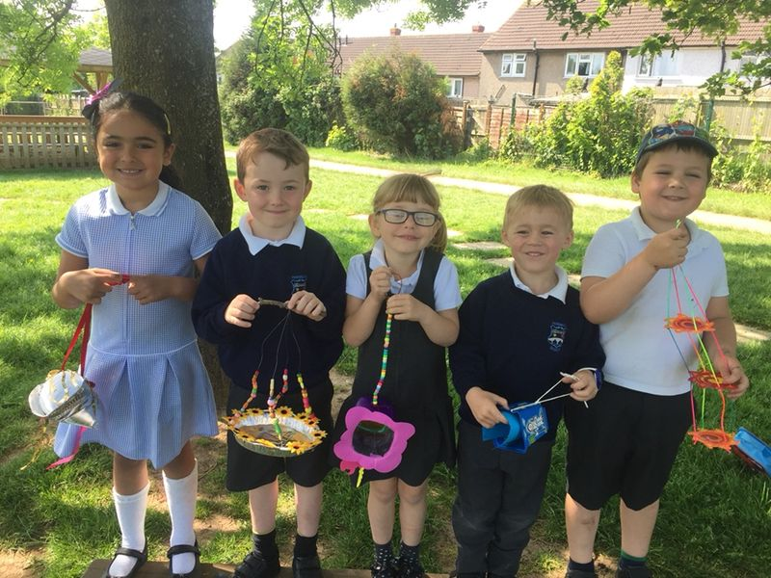
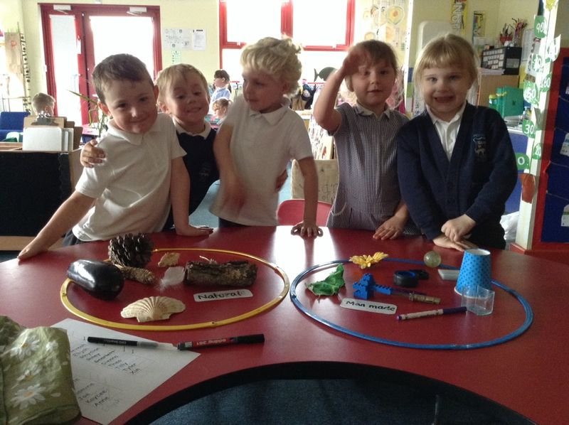
KNOWLEDGE AND UNDERSTANDING OF THE WORLD
Outdoor learning allows the children to experiment with planting and investigating what plants need to survive.
Children are given experiences that help them to enjoy learning by exploration.

Slide 13
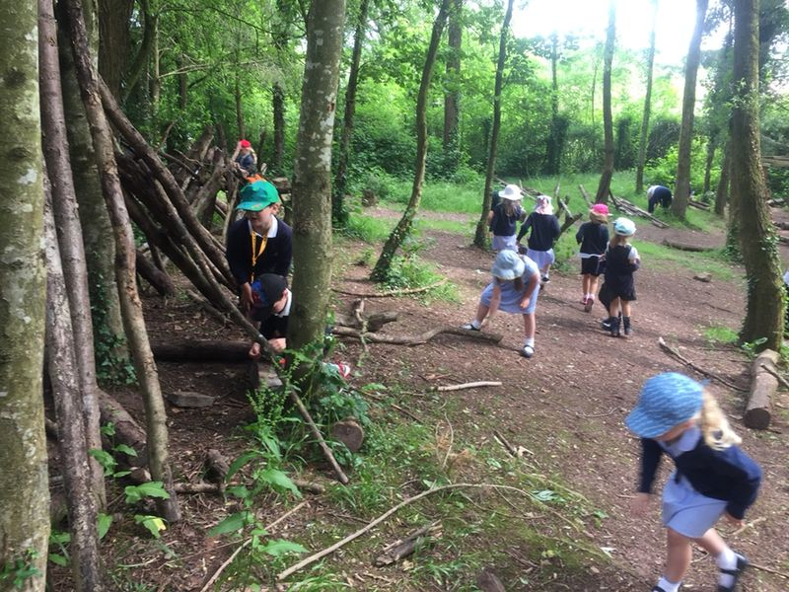
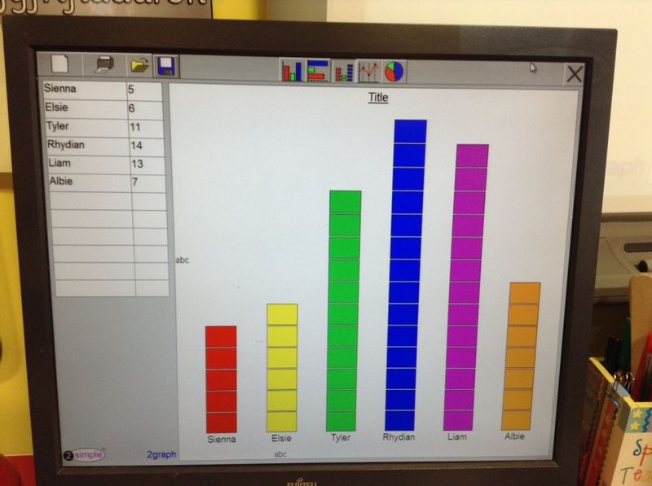
Children learn through first hand experiences and through the use of sources such as stories, photographs, maps, models and ICT.
https://youtu.be/3WKRHEUhZYY
Wales has introduced a Digital Competency Framework to ensure all children have the I.T. skills needed in life today and in the future.

Slide 14
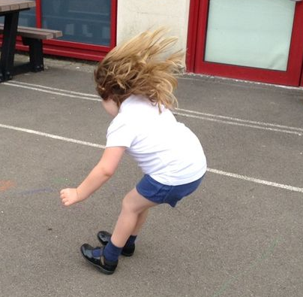
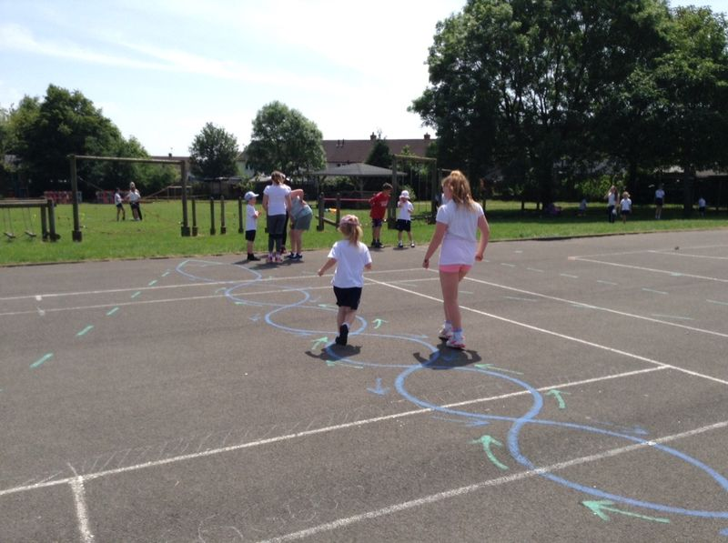
PHYSICAL DEVELOPMENT
Children are encouraged to enjoy physical activity and this is promoted by encouraging spatial awareness, balance, control and co-ordination.
http://physicalliteracy.sportwales.org.uk/en/

Slide 15
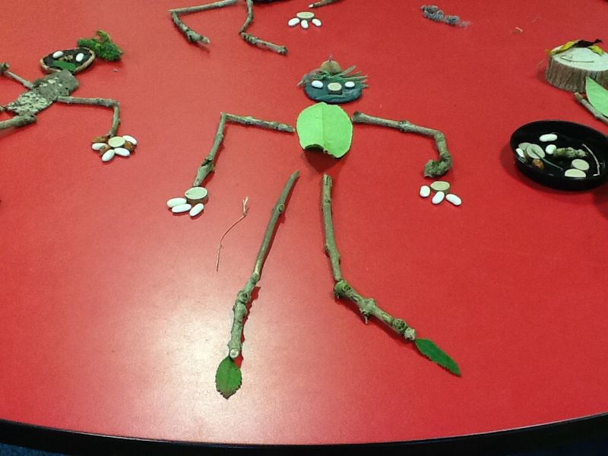
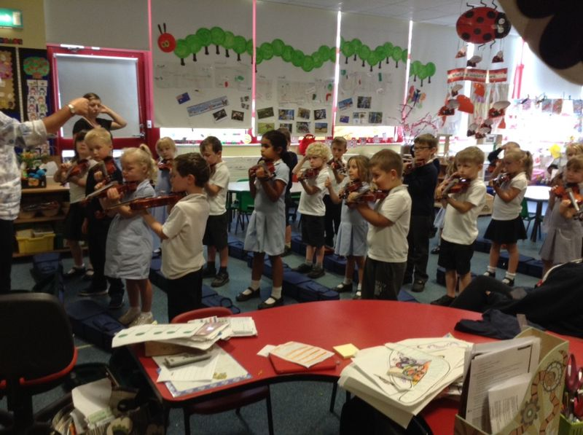
CREATIVE DEVLOPMENT
Children’s natural curiosity and disposition to learn is stimulated by everyday sensory experiences both indoors and outdoors.

Slide 16
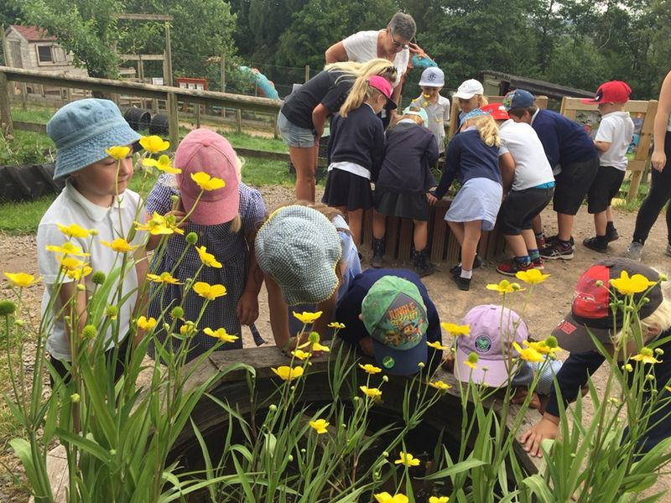
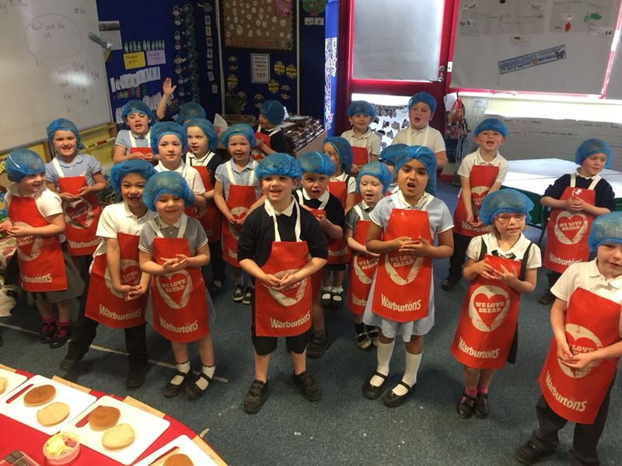
Pembroke Primary School provides a child-centred curriculum which encourages the children to be enthusiastic, independent and active learners.

Slide 17
New Curriculum – 2022
https://youtu.be/zW4kASbIw14
4 Purposes
ambitious, capable learners, ready to learn throughout their lives
enterprising, creative contributors, ready to play a full part in life and work
ethical, informed citizens of Wales and the world
healthy, confident individuals, ready to lead fulfilling lives as valued members of society

Slide 18
New Curriculum - 2022
6 Areas of Learning and Experience (AoLE).
Expressive arts.
Health and well-being.
Humanities (including RE which should remain compulsory to age 16).
Languages, literacy and communication (including Welsh, which should remain compulsory to age 16, and modern foreign languages).
Mathematics and numeracy.
Science and technology.
It will also include three cross-curricular responsibilities: literacy, numeracy and digital competence.

Slide 19
New Curriculum - 2022
Progress Steps
We will be moving away from phases and stages to a continuum of learning that flows from the ages of 3 to 16. Practitioners will be assessing learner progress along the same continuum, thus minimising the impact of transition between and within settings and schools.
Progress will be signalled through progression steps which act as reference points on the continuum, relating broadly to expectations at ages 5, 8, 11, 14 and 16.

Slide 20
New Curriculum - 2022
Teachers have been looking at and discussing the new curriculum.
We have started to plan using the new curriculum.
Children are starting to make decisions about what they want to learn – helped by adults
The 4 purposes are now at the centre of all learning activities.

Slide 21
www.pembrokeprimary@monmouthshire.gov.uk
01292 622310
@pembrokeprimary
Email- pembrokeprimaryschool@Monmouthshire.gov.uk

